Slide 1
Assignment World Food Programme Ethiopia
Optimization for Data Science
Spring 2025
Notes:
2

Slide 2
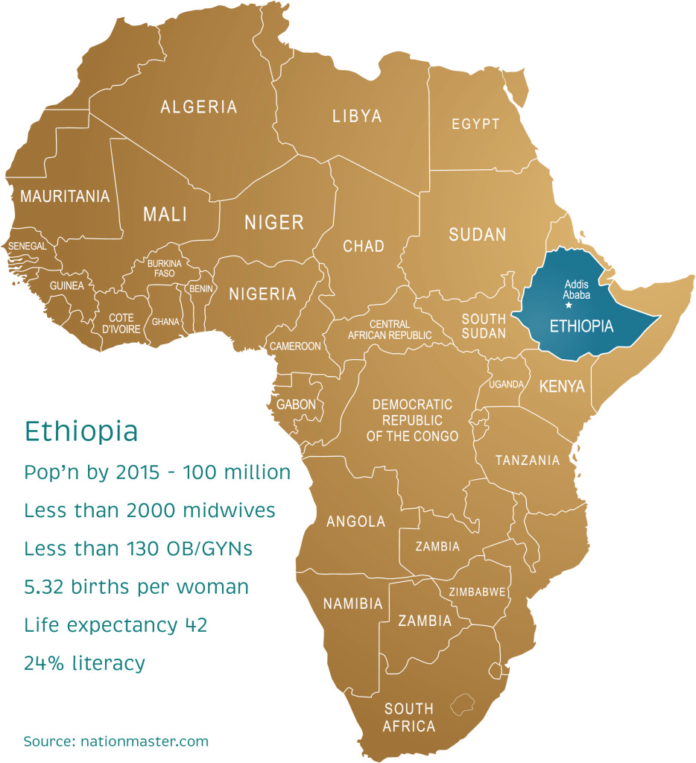
Goal
In this assignment we are going to support the United Nations World Food Programme in designing the optimal food supply chain for one month (30 days) in Ethiopia
Country: Ethiopia, 1,1 million km2 (surface of France + Spain)
Often problems with harvest (due to drought)
This is a real-life problem (only costs have been randomized) which takes into account the most important aspects

Slide 3
General
All data is available in Excel
You will see the unit of mT = metric tons = 1000 kg (but some food quantities are given in units of 100 gr)
All costs are in USD ($)
On the next slides we discuss the various entities that play a role in this case study.

Slide 4
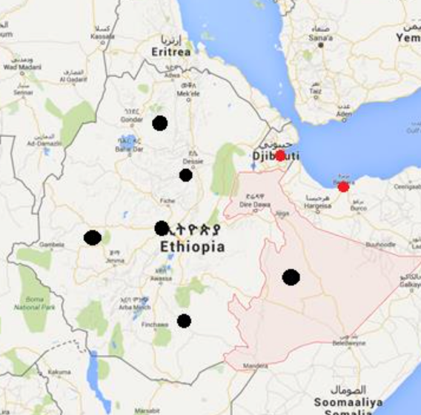
Beneficiaries
There are a lot of beneficiaries in Ethiopia that need food
This is part of the data:
LocationTYpe | Location | #Beneficiaries | Port capacity (mt/month) | Handling cost ($/ton)
Beneficiary Camp | Somali | 835737 |  | 0,00
Beneficiary Camp | ADI-HARUSH | 21524 |  | 0,00
Beneficiary Camp | AW-BARRE | 27638 |  | 0,00
Beneficiary Camp | AYSAITA | 20391 |  | 0,00
Beneficiary Camp | BAMBASI | 31554 |  | 0,00
Beneficiary Camp | BERHALE | 17672 |  | 0,00
Beneficiary Camp | DILLO | 2508 |  | 0,00
Beneficiary Camp | HITSATS | 23434 |  | 0,00
Beneficiary Camp | KEBRIBAYA | 31659 |  | 0,00
Beneficiary Camp | KULE | 93792 |  | 0,00
Beneficiary Camp | MAI-AINI | 24368 |  | 0,00
Beneficiary Camp | MEGADO | 4162 |  | 0,00
Beneficiary Camp | OKUGO | 13877 |  | 0,00
Beneficiary Camp | PUGNIDO | 149319 |  | 0,00
Beneficiary Camp | SHEDER | 24571 |  | 0,00

Slide 5


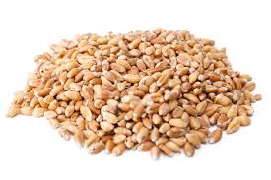
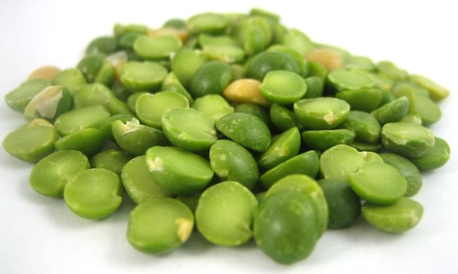
Food & Nutrients
There are several types of food (commodity) you can buy:
People need certain nutritional values:
Commodity
SORGHUM/MILLET
MAIZE
WHEAT
RICE
WHEAT FLOUR
IODISED SALT
SUGAR
VEGETABLE OIL
SPLIT PEAS
LENTILS
BEANS
CHICKPEAS
CORN SOYA BLEND
HIGH ENERGY BISCUITS
Nutrient | Nutritional daily requirements (different units)
Energy | 2.100,00
Protein | 52,50
Fat | 40,00
Calcium | 450,00
Iron | 22,00
Iodine | 150,00
Vit. A | 500,00
Thiamine | 0,90
Riboflavin | 1,40
Niacin | 13,86
Vit. C | 28,00

Slide 6
And the food contains these ingredients
Note that the nutritional values are in a certain value per 100 gr of the food!
Commodity | Nutrient | Nutritional value (value/100 gram)!!
Beans | Energy | 344,44
Chickpeas | Energy | 364,00
Corn Soya Blend | Energy | 384,25
High Energy Biscuit | Energy | 400,00
Iodised Salt | Energy | 0,00
Lentils | Energy | 338,00
Maize | Energy | 262,00
Rice | Energy | 362,36
Sorghum/Millet | Energy | 335,00
Split Peas | Energy | 341,00
Sugar | Energy | 393,33
Vegetable Oil | Energy | 882,40
Wheat | Energy | 330,00
Wheat Flour | Energy | 364,00
Beans | Protein | 24,16
Chickpeas | Protein | 19,30
Corn Soya Blend | Protein | 15,76
High Energy Biscuit | Protein | 9,00
Iodised Salt | Protein | 0,00
Lentils | Protein | 28,10
Maize | Protein | 7,74
Rice | Protein | 7,00
Sorghum/Millet | Protein | 11,00
Split Peas | Protein | 24,60
Sugar | Protein | 0,03

Slide 7
Supplying Countries
There are many supplying countries for the types of food
Note that not all food can be bought in every country
Furthermore, there is a maximum in metric tons that can be bought in the coming month
The cost to procure the food are specified in the last column
Supplier | Commodity | Procurement capacity (ton/month) | Procurement price ($/ton)
AUSTRALIA | CHICKPEAS | 1000 | 696,26
AUSTRALIA | LENTILS | 1000 | 1096,76
AUSTRALIA | RICE | 15000 | 931,51
AUSTRALIA | SPLIT PEAS | 1000 | 884,10
AUSTRALIA | WHEAT | 15000 | 365,03
BELGIUM | CORN SOYA BLEND | 3000 | 1023,09
BELGIUM | SUGAR | 1000 | 554,61
BELGIUM | VEGETABLE OIL | 2000 | 1063,18
BRAZIL | IODISED SALT | 1000 | 196,86
BRAZIL | RICE | 15000 | 509,61
BRAZIL | SUGAR | 1000 | 538,07
BULGARIA | WHEAT | 15000 | 284,32

Slide 8
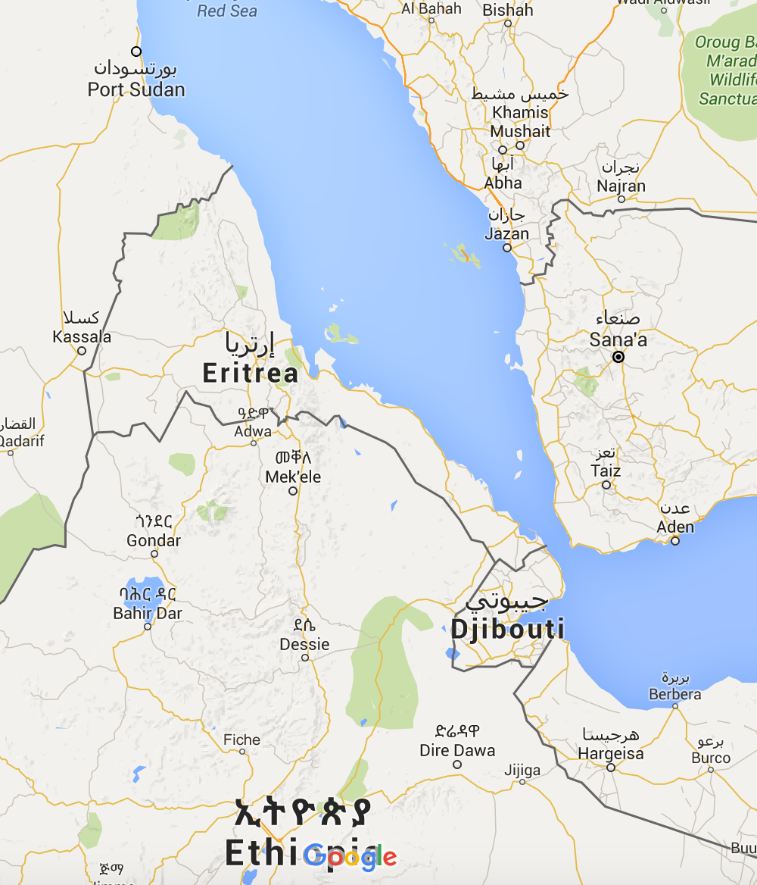
Ports
And with big ships the food arrives from the supplying countries in four possibly ports (and Mombasa; not on the map)
The port capacity is given as well as the handling cost (in $/ton)
BERBERA (SOMALIA) | 20.000 | 16,00
DJIBOUTI (DJIBOUTI) | 75.000 | 23,45
PORT SUDAN (SUDAN) | 60.000 | 23,50
MOMBASA (KENYA) | 60.000 | 30,00

Slide 9
Cost of transporting from countries to the ports
There are sea transportation costs involved depending on supplier, port and commodity
Origin | Destination | Commodity | SeaTransport cost ($/ton)
PAKISTAN | DJIBOUTI (DJIBOUTI) | RICE | 23,2
PAKISTAN | DJIBOUTI (DJIBOUTI) | IODISED SALT | 31,3
BELGIUM | DJIBOUTI (DJIBOUTI) | CORN SOYA BLEND | 40,6
INDIA | PORT SUDAN (SUDAN) | RICE | 43,7
BELGIUM | DJIBOUTI (DJIBOUTI) | SUGAR | 43,0
TURKEY | PORT SUDAN (SUDAN) | RICE | 33,1
INDIA | DJIBOUTI (DJIBOUTI) | RICE | 34,6
INDIA | DJIBOUTI (DJIBOUTI) | SORGHUM/MILLET | 36,5
INDIA | DJIBOUTI (DJIBOUTI) | WHEAT | 48,9
TURKEY | PORT SUDAN (SUDAN) | BEANS | 46,0
TURKEY | PORT SUDAN (SUDAN) | LENTILS | 50,4
TURKEY | PORT SUDAN (SUDAN) | PEAS | 47,6
TURKEY | PORT SUDAN (SUDAN) | SPLIT PEAS | 50,3
BELGIUM | PORT SUDAN (SUDAN) | CORN SOYA BLEND | 36,0
BELGIUM | PORT SUDAN (SUDAN) | SUGAR | 48,5

Slide 10
Land Transport to Warehouses
Arrived and handled in the port the goods can be transported from the ports to warehouses
In the file you’ll also find warehouses and they have their own handling cost and capacity
The possibilities with costs are given in the table ($/ton)
Warehouse | <NAZARETH> | 0 | 152.835 | 11,71
Warehouse | <MEKELE> | 0 | 10.000 | 16,58
Warehouse | <JIJIGA> | 0 | 16.500 | 13,77
Warehouse | <KOMBOLCHA> | 0 | 16.150 | 12,35
Warehouse | <GODE> | 0 | 5.050 | 16,30
Warehouse | <DIRE DAWA> | 0 | 34.121 | 15,57

Slide 11
Land from Warehouses to Camps
From the warehouses food is transported to the camps
Origin | Destination | Landtransport cost ($/ton)
DJIBOUTI (DJIBOUTI) | <JIJIGA> | 78,82
DJIBOUTI (DJIBOUTI) | <MEKELE> | 74,45
DJIBOUTI (DJIBOUTI) | <NAZARETH> | 62,21
DJIBOUTI (DJIBOUTI) | <GODE> | 156,57
DJIBOUTI (DJIBOUTI) | <KOMBOLCHA> | 35,28
DJIBOUTI (DJIBOUTI) | <DIRE DAWA> | 51,72
BERBERA (SOMALIA) | <JIJIGA> | 56,13
BERBERA (SOMALIA) | <NAZARETH> | 102,13
BERBERA (SOMALIA) | <KOMBOLCHA> | 172,72
MOMBASA (KENYA) | <NAZARETH> | 308,47
PORT SUDAN (SUDAN) | <NAZARETH> | 116,05
<DIRE DAWA> | Oromiya | 44,10
<DIRE DAWA> | Somali | 65,97
<GODE> | Somali | 104,52
<KOMBOLCHA> | Afar | 43,50
<KOMBOLCHA> | Amhara | 60,53
<KOMBOLCHA> | Tigray | 17,56
<NAZARETH> | Afar | 88,46
<NAZARETH> | Amhara | 50,71
<NAZARETH> | Benshangul | 58,37
<NAZARETH> | Gambella | 46,78
<NAZARETH> | Oromiya | 63,87

Slide 12
Assignment
In this assignment you will use linear programming and integer linear programming to construct the optimal supply chain. Your goal is to provide recommendations to the world food program not only about where to buy and ship food, but also about which changes to the network are most effective with respect to reaching the goal (feeding more beneficiaries at the same cost).
Formulate a linear program that allows you to design the optimal supply chain. Your solution should decide which food to buy, where to buy it, to which port to transport it, and how to transport it from the port via which warehouse to which camp. Make sure your solutions respects all restrictions! (e.g. all beneficiaries are fed, procurement, warehouse & port capacities)
Solve the linear program (using CVXPY) and perform a sensitivity analysis.
For the sensitivity analysis, you should use the methods discussed in class.
Illustrate your sensitivity analysis by designing two alternative scenarios (in which for example demand increases, capacities decrease, shipping routes are disrupted). For each of the scenarios, solve the linear program again and explain how your observations relate to the sensitivity analysis from 2.1.
The model from 1 assumes all variables are real numbers. For some variables this is a reasonable assumption (kilograms of rice for example), for other variables this is less realistic. Formulate and solve an alternative mixed-integer linear program. Motivate your choice of decision variables.

Slide 13
Assignment
The final output of your assignment is a report that should consist of the following elements:
A formulation of the supply chain problem as a linear program (max 1 page).
Clearly state (and explain) the decision variables, the objective function, and all constraints.
A description of the solution of your linear program (max ½ page).
The half a page description should help the world food program understand the high-level properties of your solution, for example: which percentage of the food is supplied by which country? Through which ports does it go? Warehouses?
A sensitivity analysis of your linear programming solution (max 1.5 page).
Use half a page to discuss the shadow prices of your solution (see lectures). Based on those, design two alternative scenarios (see previous slide). Solve the LP for those scenarios and discuss how the solution relates to the shadow prices (1/2 page per scenario)
A mixed-integer formulation of the supply chain problem (max 1.5 page).
Motivate your choice of variables (discuss for example the impact of making a variable integer vs real), max ½ page. Solve the mixed-integer formulation and present the key characteristics as for the linear program, max ½ page. Explain the key differences between the solution of your LP and mixed-integer program, max ½ page.
Conclude with recommendations for the world food program (max ½ page): what are the most sensitive aspects of the supply chain? How could they feed more beneficiaries?

Slide 14
Assignment
Assessment:
The report will be graded on the elements described on the previous slide.
We will pay special attention to the following aspects:
Clarity of the reasoning that explains how you designed your models.
Conciseness. The previous slide gives strict page limits for the various parts of your report. You may provide supplementary information to support the main report in an appendix to be placed at the end of the report. (It should not be necessary to read the appendix to understand the main report; the appendix will in principle not be graded.)
Do not hand in the code that you used, but keep it, as we might ask for it later!

Slide 15
Credits:
This case study was originally designed by Hein Fleuren and Koen Peters.
The case study is very much related to the work
done at the Zero Hunger Lab.
(The guest lecture in week 7 will be given by Joris Wagenaar from the Zero Hunger Lab.)

